Slide 1
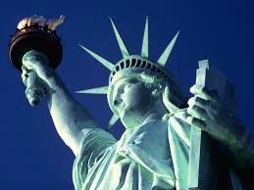
How can the structure of a sonnet affect its meaning?
On Post-it notes:
Identify something interesting in your line
Suggest what might be meant by the line
Ask a question of your line
Example: “conquering limbs astride from land to land;”
Repetiton/ use of semi-colon
‘Conquering’ is a powerful active verb and might suggest winning a battle
Question – what has been conquered? Why was it necessary to conquer?

Slide 2
A mighty woman with a torch
Not like the brazen giant of Greek fame
Send these, the homeless, tempest-tost to me,
I lift my lamp beside the golden door!”
The New Colossus
https://www.youtube.com/watch?v=Y3utCntXrPo

Slide 3
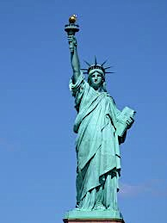
True or False?
The Statue of Liberty was given to America as a gift from France in 1886.
The seven spikes of her crown represent the 7 seas and continents.
Lady Liberty’s hand embraces a tablet inscribed with the date of American Independence (July 4th 1776).
There is a broken chain at the feet of Lady Liberty symbolising freedom in the US.
She became the symbol of immigration during the second half of the 19th century, as over 9m immigrants came to the US. She was often the first thing they saw when arriving by boat.

Slide 4
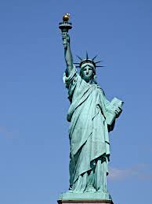
Group Reading
The New Colossus
BY EMMA LAZARUS
Not like the brazen giant of Greek fame,
With conquering limbs astride from land to land;
Here at our sea-washed, sunset gates shall stand
A mighty woman with a torch, whose flame
Is the imprisoned lightning, and her name
Mother of Exiles. From her beacon-hand
Glows world-wide welcome; her mild eyes command
The air-bridged harbor that twin cities frame.
“Keep, ancient lands, your storied pomp!” cries she
With silent lips. “Give me your tired, your poor,
Your huddled masses yearning to breathe free,
The wretched refuse of your teeming shore.
Send these, the homeless, tempest-tost to me,
I lift my lamp beside the golden door!”
http://www.theguardian.com/books/2012/jun/04/poem-week-new-colossus-emma-lazarus
http://education-portal.com/academy/lesson/petrarchan-sonnet-rhyme-scheme-format-example-poems.html#lesson

Slide 5
A Petrarchan Sonnet (the Italian sonnet)
Which words rhyme?
Can you identify any alliteration in the sonnet?
Identify the rhyming pattern (A,B, C, D). What is interesting or unusual about the rhyme structure compared to other more traditional sonnets you’ve studied?
Where is the point of change (or volta) in the sonnet?
How might we label these parts?

Slide 6
Structure: Octave (8 lines), Sestet (6 lines)
A - Not like the brazen giant of Greek fame,
B - With conquering limbs astride from land to land;
B - Here at our sea-washed, sunset gates shall stand
A - A mighty woman with a torch, whose flame
A - Is the imprisoned lightning, and her name
B - Mother of Exiles. From her beacon-hand
B - Glows world-wide welcome; her mild eyes command
A - The air-bridged harbor that twin cities frame.
C - “Keep, ancient lands, your storied pomp!” cries she
D - With silent lips. “Give me your tired, your poor,
C - Your huddled masses yearning to breathe free,
D - The wretched refuse of your teeming shore.
C - Send these, the homeless, tempest-tost to me,
D - I lift my lamp beside the golden door!”
Is there a set rhythm? How might this be described?

Slide 7
How might I craft a Petrarch sonnet?
First, build a word-wall to help gather ideas
Examples of a Petrarch structure:
Problem – I’ve broken my leg and I’m wearing a cast – restrictions, pain, itch, etc.
Solution – The cast is removed – describe the experience, emotions felt…
Or
Offer a new perspective – i.e. take up a new hobbies and interests
Question – How will I get Mum to buy me an iPhone 6? Suggest solutions
New perspective – Mum’s voice
Character Viewpoint – Magwitch, inspired by “Keep still, you little devil, or I’ll cut your throat!”
Alternative character perspective – Pip, “..Don’t cut my throat, sir”

Slide 8
Which style will you model your own sonnet on?
Shakespearean | Petrarch | Dramatic Monologue | Contemporary
Sonnet 19 Sonnet 116 | The New Colossus | Anne Hathaway | I am Very Bothered
Iambic Pentameter | Iambic Pentameter | Free Verse (final two lines rhyming couplet) | Free Verse
ABAB, CDCD, EFEF, GG | ABBA, ABBA CDCDCD | ABCDEFGHIJKL MM | You decide whether to include rhyme or not
Thematic Symbolism | Problem/ question/ idea Solution/ new perspective | Perspective and voice Symbolism | Imagery

Slide 9
Reflection: CSI/ Headline
On your post-it note either:
Reflect on the most appropriate Colour, Symbol and Image for the Petrarch sonnet explored today
Or
Write a newspaper headline reflecting what you have learnt from today’s lesson

