Slide 1
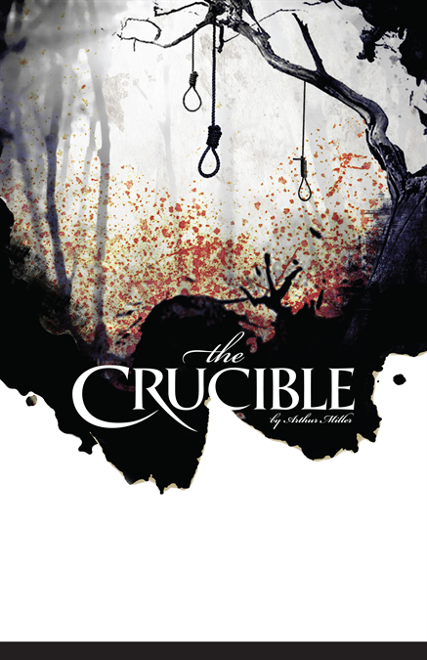
The Crucible
An Overview

Slide 2
Plot Overview
Act One – Betty Parris will not wake up. The people of Salem suspect witchcraft and have called Reverend Hale to investigate. The girls accuse others of witchcraft.
Act Two – John and Elizabeth Proctor discuss the events thus far. Mercy Lewis returns home and they discuss what has happened in the court. Elizabeth is accused of witchcraft by Abigail and, along with Rebecca and Martha, taken to jail

Slide 3
Plot Overview
Act Three – Proctor, Francis and Giles go to court with Mercy Lewis. Mercy claims that the girls are pretending, and they turn against her. John admits his affair with Abigail but Elizabeth lies for him. He is arrested.
Act Four – Hale and Danforth persuade Proctor to plead guilty. He does, then changes his mind when asked to sign his name. He is hanged.

Slide 4
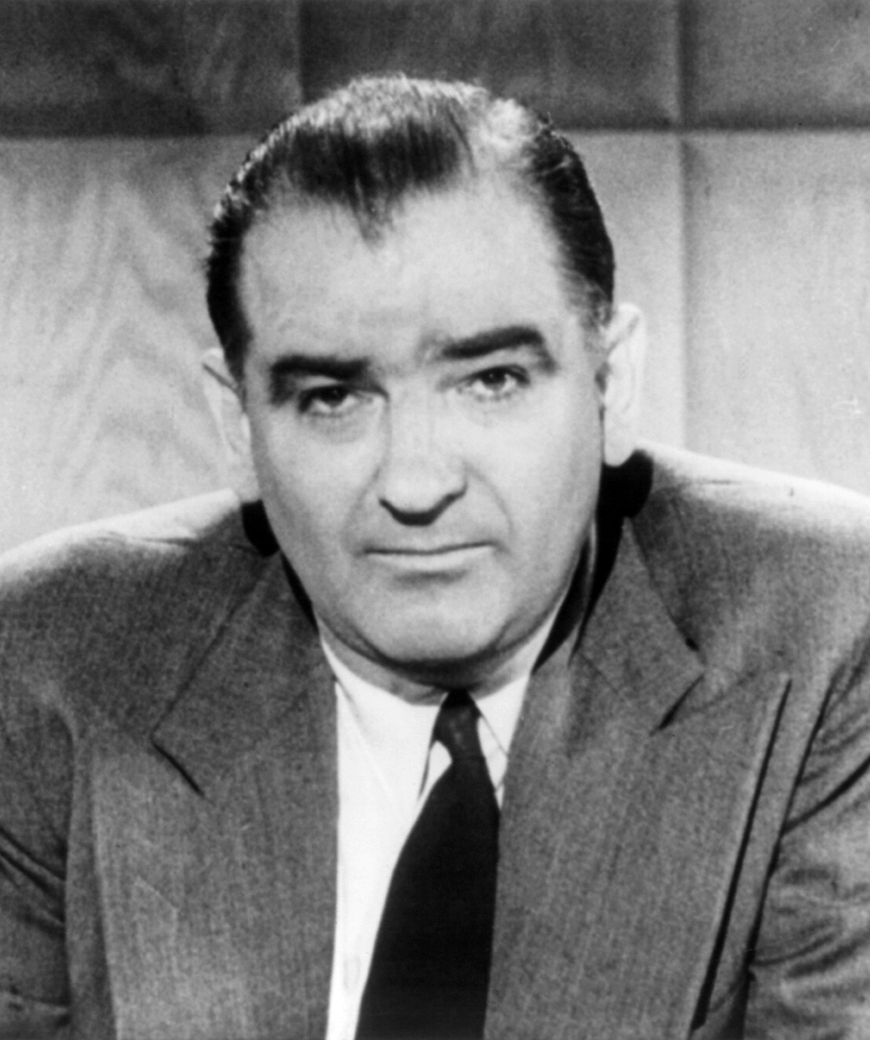
Context
Written in 1952 and first performed in 1953
Middle of McCarthyism – several of Miller’s friends had been questioned by HUAC
Miller himself was questioned by HUAC and, when asked to name others who had attended a Communist party said, “I could not use the name of another person and bring trouble on him”

Slide 5
Allegory
Allegory: a device in which characters or events represent or symbolise ideas and concepts
The Crucible can be viewed as an allegory for the Second Red Scare and McCarthyism
In the play, Miller creates links between the Salem Witch Trials and McCarthyism through explicit reference, the plot, characters, and the themes of fear, justice, the power of names, and mass hysteria

