Slide 1
Shocking Advertisements
Cultural Assumptions in Marketing - Advertising

Slide 2

Advert 1

Slide 3

Advert 2

Slide 4

Advert 3

Slide 5

Advert 4

Slide 6

Advert 5

Slide 7

Advert 6

Slide 8

Advert 7

Slide 9

Advert 8

Slide 10
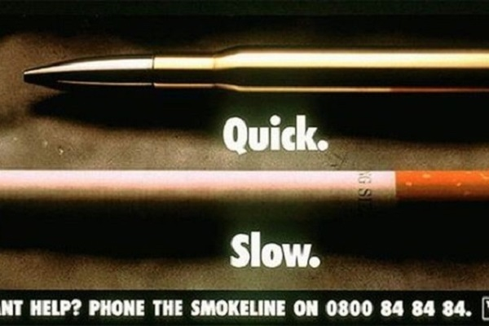
Advert 9

Slide 11
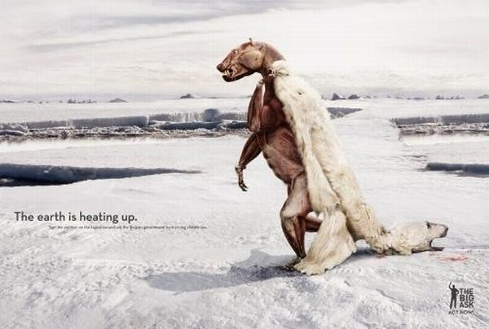
Advert 10

Slide 12

Advert 11

Slide 13

Advert 12

Slide 14

Advert 13

Slide 15

Advert 14

Slide 16

Advert 15

Slide 17
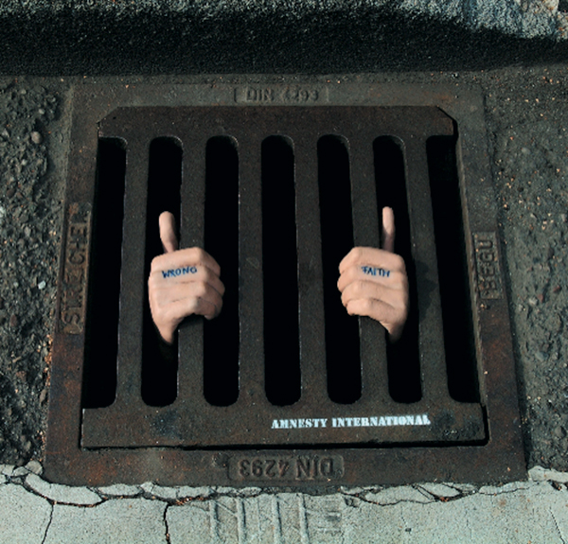
Advert 16

Slide 18
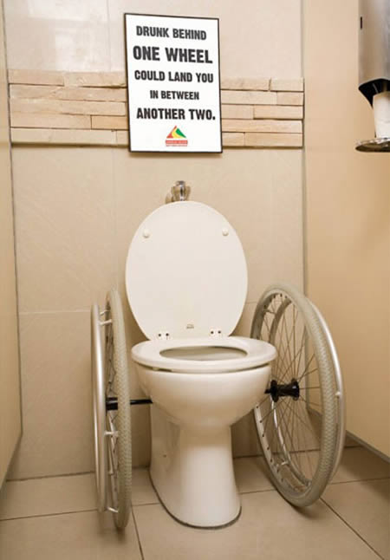
Advert 17

Slide 19
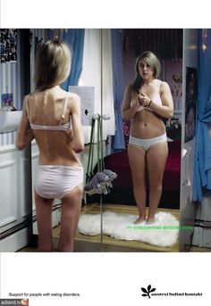
Advert 18

Slide 20
The Importance of an Image
1. What is the image of?
2. Is it shocking or unusual in any way? Why?
3. What is the purpose of using that image? What was the purpose of the agency when they chose that image?
4. Do you think it worked well?
5. Are you persuaded by those techniques?
6. Would you change that ad in any way?

Slide 21
Task 1
In pairs, collate shocking advertisements of your own.
Find a total of 5. We will be sharing your most shocking advertisement with the class. Be prepared to discuss in detail what makes the advert so shocking and effective.

Slide 22
Task 2
→ Working in pairs, research in the internet for a shocking image. Copy and paste the image onto a word document and add a very short text to it to make it your own advertisement.
Write no more than a couple of short sentences to make it effective.

