Slide 1
Sex & Gender
By: Tien Yi, Herman & Jasmine Y10P

Slide 2
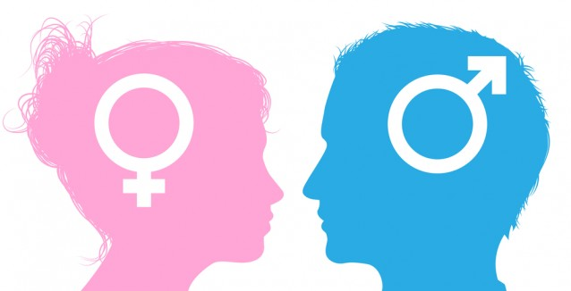
Introduction
Historically, both terms “Sex” and “Gender” have always been mixed up and misunderstood. However, nowadays, their meaning is becoming more distinctive.¹
Generally -
“Sex” refers to the differences between males and females from a biological perspective.¹
“Gender” refers to the role of a male or female in society, or a person’s own perception of being male/female, which could differ from their biological sex.¹
In the 1920s, there were significant changes in gender roles, women became more confident in individual beliefs and men and women’s roles started becoming less distinctive.
1 Medical News Today. MediLexicon International, n.d. Web. 26 Aug. 2016.
Notes:
Herman

Slide 3
Gender Expectations & Socialization before 1920’s

Slide 4
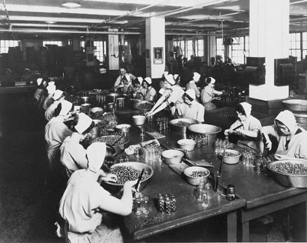
Socialisation of women before 1920’s in America
Before the 1920’s, women and men were expected to behave and socialized in a completely different way in society.¹
Men were expected to:¹
Be out working and earning money for their households
socializing with other men in public (clubs, meetings or bars).
Women were expected to:¹
Take care of the cooking, cleaning
taking care of children.
Not allowed to be socialising during free time
Marry and have children²
Any wealth or earnings are passed to their husband²
Woman didn’t have the same opportunities as men, because of their lack of education due to traditional expectations. They were also not eligible to contribute in any political activity.
1 "Feminism in the 19th Century: Women's Rights, Roles, and Limits." Study.com, n.d. Web. 26 Aug. 2016.
2 "Spartacus Educational." Spartacus Educational. N.p., n.d. Web. 26 Aug. 2016.
Notes:
Herman

Slide 5
Marriage for Women & Female’s Dependence on Men
Women were destined to be married. It was also their top priority in life.
Single women would be pitied.
Married women would become housewives
Main role is to produce food and clothing for the household
Whereas, men would be earning money for the family.
Women were discouraged to work after marriage, statistically speaking, only ~8-10% of married women were employed during those times¹.
Marriage was expected to be a permanent commitment. Though divorce was legally permitted, it was strongly condemned.
1 Onion, Rebecca. "Vintage Infographics: Where Women Worked in 1920." Slate Magazine. N.p., 11 Mar. 2013. Web. 26 Aug. 2016.
Notes:
Tien Yi

Slide 6
Women’s rights before 1920
Women faced difficulties and were always exhausting and socially unappreciative in the 18th century since they have to serve their household all day. E.g: cook meals, doctor their families, make household goods and sell etc.
Women were often considered men’s property and were required to marry their husbands at a young age.
Not allowed to show much skin.
Women are not allowed to vote.
Notes:
Jasmine

Slide 7
Change of social status among genders throughout the 1920’s

Slide 8
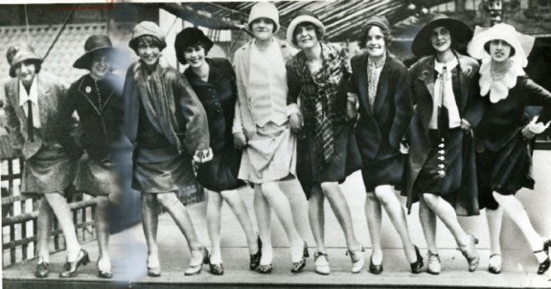
Introduction of Flappers and the New Woman
‘Flappers’ emerged after WW1 and became more prevalent in the roaring twenties.
They were the ‘new women’ of the 1920’s in America who wanted to express individuality, hence, they dressed and behaved in a manner that went against the social norms of those times.
Notes:
Tien Yi

Slide 9
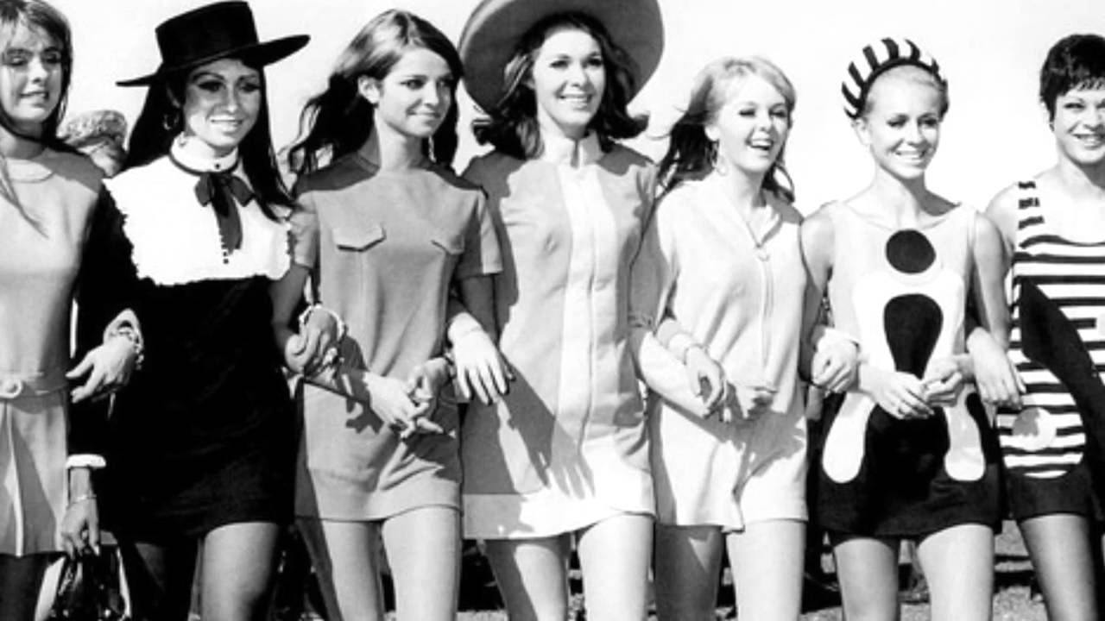
Social changes in the 1920’s (Fashion Trends)
The 1920s were the decade that people started to be more aware about fashion, and their individual representation. The jazz age changed everyone’s life, and it was significantly reflected in their clothing.²
Women -
Sportswear (Targeted at young women)
Short skirts with pleats
Cloche hat (Hat which is fitted, bell shaped)
Expectations/Behaviour of a Gibson Girl:¹
Long loose hair
High collar skirt
No makeup
Can only go on dates that parents set up
No smoking or drinking (Not lady like)
Expectations/Behaviour of a Flapper Girl:¹
Short bobbed hair
Short skirts just above or below the knee
Dramatic makeup
Casually date whomever you like
Smoking and drinking are allowed
1 "The Gibson Girl Vs. Flapper." The Roaring 20's. N.p., n.d. Web. 26 Aug. 2016.
2 "A New Society: Economic & Social Change." A New Society: Economic & Social Change. N.p., n.d. Web. 26 Aug. 2016.
Notes:
Herman

Slide 10
Social changes in the 1920’s (Fashion Trends)
Fashion is a reflection of the period of time and what’s going on in the culture on a social, economical and political level. ¹
Symbolism in women’s clothing style -
Colour blue (Standard colour for women’s dress) = coolness, restful and unobtrusive
Clothing inspired by menswear = shows that women gained more political and social power³
Hats (especially Cloche Hat) = it shows feminism, a recognizable new look of the “new woman”.²
1 "1920s Fashion Was a Time of Great Social Change." The Finer Times: War, Crime and History Resource. N.p., n.d. Web. 26 Aug. 2016.
2 "Hats and Hair 1920-1930." Hats and Hair Fashion History 1920-1930. N.p., n.d. Web. 26 Aug. 2016.
3 "The Influence of 1920s Fashion." The Macaulay Messenger. N.p., 05 May 2013. Web. 26 Aug. 2016.
Notes:
Herman

Slide 11
Change in Rights of Women and Men in the 1920s
After the 19th Amendment, women gained the right to vote in 1920.
Women wore clothing more convenient for activity. They used to wear short dresses and shirts which were straight and loose. Their arms have to be bare and the waistline should be dropped to their hips. From 1927, the skirts had been lengthened to their knees which will be shown when they dance.
Women had the right to do something else other than just staying at home taking care of their children and working in their household.
Around 15% of factory-working women became professionals.
Women began to earn their own money and prove they have the ability to earn money.
Acceptance of “new women”
Notes:
Jasmine

Slide 12
Female’s Level of Independence
The 19th amendment led to women’s social and political empowerment, as they then bore voting rights (and hence, political say) that were independent from their husbands.
Housewives also took more charge in the household, they were now expected to handle the household’s expenses, completing chores etc. As a result, men were less dominant in the household.
The rise of corporate businesses opened up occupations such as typists, filing clerks, and even some secretarial roles (which were usually reserved for men, who were thought to be more intelligent) to women. Employment rates among women rose, thereby making women less financially dependent on men.¹
As women’s sexuality became less suppressed, infidelity, immodesty and divorce became less condemned. Hence, women became less bound by marriage and were viewed lesser of an adjunct to men.²
1 "Working and Voting -- Women in the 1920s." American History USA. N.p., n.d. Web. 26 Aug. 2016.
2 Morales, Nicole. "Gatsby and Gender Roles." Prezi. N.p., 8 May 2013. Web. 27 Aug. 2016.
Notes:
Tien Yi

Slide 13
Linking Context to Literature

Slide 14
Marriage and Love
Victorians believed that marriage should be based on love. However, in the Great Gatsby, Marriage ≠ Love.
For instance, Daisy and Tom Buchanan’s marriage and Myrtle’s infidelity.
The insignificance of Daisy’s infidelity reflects less repressed female sexuality
Notes:
Tien Yi

Slide 15
Male dominance
The appearance of flappers
When Nick mentioned ‘the Tom Buchanans’
Men were the ones who were earning money for women to spend on themselves
When Tom exerted physical force on Myrtle
Portrayed using Jordon Baker
Loved joining Gatsby’s parties
Plays golf
Notes:
Tien Yi

Slide 16
Thank You for watching!
Notes:
All

