Slide 1
Starter…
If you were to leave the place where you live, what things would you:
A: Miss about it?
B: Not miss about it?
You could also answer this question based on somewhere you have lived.

Slide 2
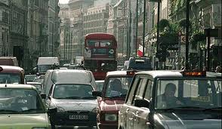
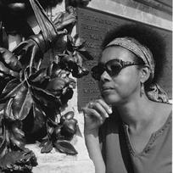
Island Man – Grace Nichols

Slide 3
First Reading
Split your page in half and list the things the island man associates with his island home on one half of the page and with London on the other half.

Slide 4
First Reading
In your groups, practice reading the poem aloud.
Decide where to pause and think about what words should be read quickly or slowly and what words should be emphasised

Slide 5
Context
Read the following contextual information. In what ways does Grace Nichols create a picture of two worlds in Island Man?
Grace Nichols was born in Guyana in 1950. After university, she worked in the Caribbean as a journalist and reporter until she moved to Britain in 1977. She now lives and writes in Sussex. In an interview she said:

Slide 6
Interview
“I feel at home now both in Guyana and in England. When I’m in Guyana or another part of the Caribbean – because I see myself as coming form the wider Caribbean also – I feel I belong there because I spring from that landscape. But partly I have children in England, I also feel at home in this culture, with their dreams and aspirations. So I embrace both. England is where I live, where I make my living, but when I’m in England I’m always looking back. Both as a writer and as an individual, I’m always looking at both worlds.”

Slide 7
Structure
The poem is set out unusually. Can you find evidence for arguing that:
The poem is divided into six stages
Two distinct parts of the poem are separated by one line
There are three separate parts of the poem

Slide 8
Structure
The shape of this poem is unusual or irregular. Why do you think the poet chose to set the poem out in this way?
In what ways are the first three lines of the poem reflected in the last three?

Slide 9
Language
Create a Spider Diagram, of the different images used in the poem.
Then….
Make notes about each image on your diagram, stating what these words / images suggest to you

Slide 10
Language continued
Write down the verbs the poet uses to:
A: Describe the island in lines 5-8
B: Describe London in lines 13-15

Slide 11
Explorations and Insights
Grace Nichols wrote Island Man ‘for a Caribbean island man in London who still wakes up to the sound of the sea’. Why do you think such a man would come to live in London?
What does the poet suggest to you about the way he might feel?

Slide 12
Explorations and Insights
What does the poem imply about culture and its importance?

Slide 13
Explorations and Insights
On the surface this poem seems to be about the difference between a Caribbean island and London. Underneath it’s about the dreams and realities that we all have to deal with.
In what ways do you think this is an accurate description of the poem Island Man?

Slide 14
Extension Task
Write a poem that contains a contrast between dream and reality. You could write it from personal experience or from your imagination.
Due Thursday 6th December. It must be at least 2 stanzas in length. Each stanza must have at least 5 lines.
Use poetic techniques!!!!`

