Slide 1
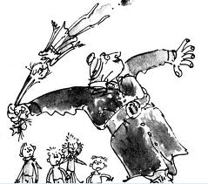
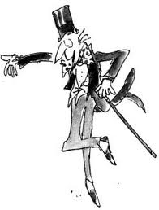
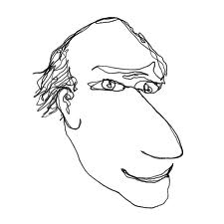
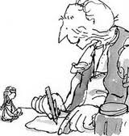
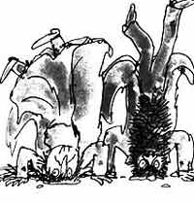
Roald Dahl

Slide 2
What are recount texts?
It is written about something that happened.
It may use a descriptive, story-like style although it is factual.
It is written in the past tense.
It makes it clear when things happened, and in what order.
It uses connectives that are temporal (linked with time), such as words like then, next, first, secondly, before and after.

Slide 3
Past tense | Present tense | Future tense
I walked | I walk | I will walk
 | I run
 |  | I will draw
I shouted
 | I yell
I wrote
 |  | I will eat
 | I sleep
 |  | I will drink

Slide 4
Activity
Write a recount of a holiday or day trip
Make sure you write in the correct tense!

