Slide 1
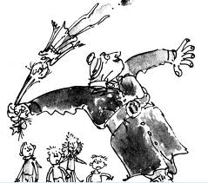
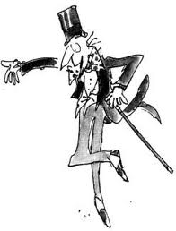
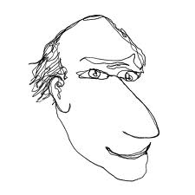
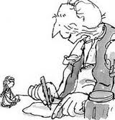
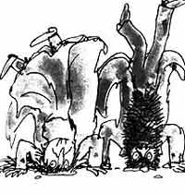
Roald Dahl

Slide 2
Mr Coombes
After we have finished reading you will be summarising the chapter. As we read you need to make notes on the 5ws to help you.
Question | Notes
Who?
What?
Where?
When?
Why?

Slide 3
Paired Task
Using your notes you need summarise the chapter for a news bulletin.
You must cover the 5ws.
However – you are not allowed to write anything down!
Extra Challenge:
Can you summarise in less
than a hundred words?

