Slide 1
How can symbolism and perspective shape our understanding of a sonnet?

Slide 2
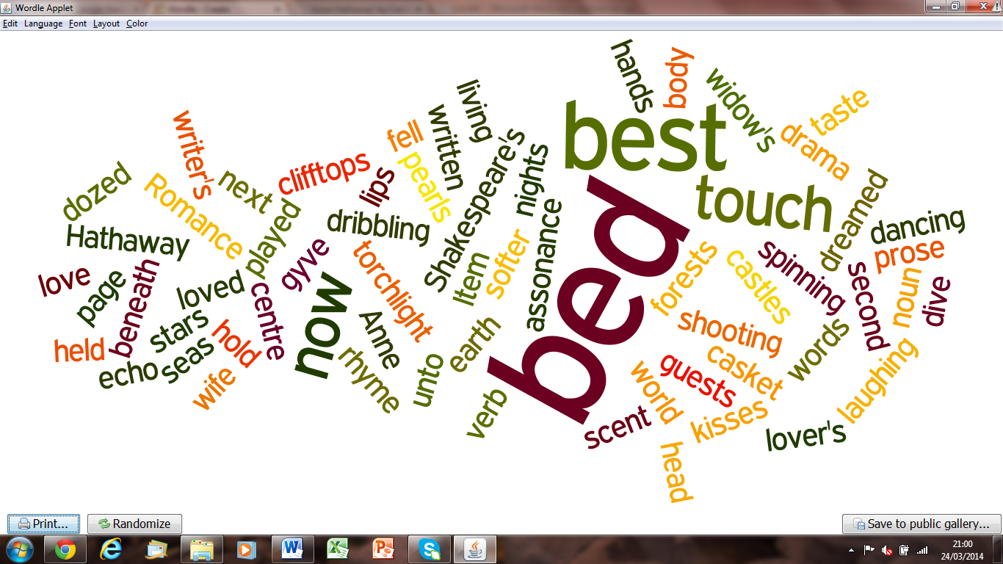
How might these words be grouped?

Slide 3
Possible ideas from our perspective:
Senses
Verbs (mostly active, some past)
Body parts
Names
Semantic field of reading/ writing
Semantic field of fairytales
Words we might associate with Shakespeare
Others?

Slide 4
These words make up ONE sonnet.
Green - Suggest a symbol or image likely to be in the poem.
Pink - Why might the words be different size?
Blue - Make a prediction of the the poem’s title.

Slide 5
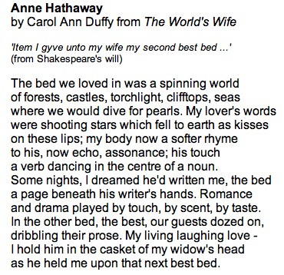
Group Reading
Highlight:
The biggest words from the wordle
Any words referring to Shakespeare
What might symbolism be?
What clues help us identify the speaker?
What clues suggest the person being spoken about?
What is a dramatic monologue?

Slide 6
Exploring the sonnet
Reminder: Glossary of sonnet terms
Green - Imagery – identify examples of the speaker presenting happy or positive ideas. Can any of these be labeled as literary devices?
Pink - Language and tone – examine the author’s use of verbs in particular. How do the verb tenses effect our interpretation of the poem and our understanding of the speaker’s perspective?
Blue - Structure and form – what is interesting or noteworthy about the way the poem has been crafted? Consider use of stanza/ verse; any rhyme; use of punctuation; the effectiveness of the dramatic monologue at conveying ideas.

Slide 7
Reflection: 3-2-1/ Headline
3 – Significant ideas, symbols, or images from the poem
2 – Summary sentences (one on symbolism; one on perspective)
1 – Question, to put to either:
the speaker (Anne Hathaway)
Or
the person spoken about (William Shakespeare)
or
the poet (Carol-Ann Duffy)
OR
Create a newspaper headline that gets “to the heart” of this poem.

