Slide 1
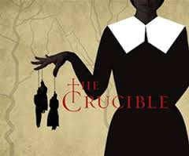
Act Two – Drama Focus
‘Context is all’ - The Crucible

Slide 2
Inquiry Questions
How can we stage the Act 2 extract to show the complex emotional relationship between Proctor and Elizabeth?
How can we use stylised / symbolic movement to explore key characters and themes from the play so far?

Slide 3
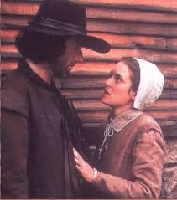
Relationships
What barriers to expressing love might have existed in 1692 Salem?
Why do you think Proctor and Abigail had an affair? Why is it surprising?

Slide 4
Task:
Freeze frames: in groups of four create two freeze frames contrasting each other. One will be of Abigail and Proctor and the other of Proctor and Elizabeth. Really show the difference in their relationships. Contrast the love and the lust, as well as the respect factors.

Slide 5
Task:
A section of text: With the person next to you read through the extracts. Think about the importance of these scenes.
Summarise what happens in a tweet! 140 characters…
Why is this scene here?
What is the importance of the stage directions?
Challenge: What subtext can be generated by actors in the extract? How? When?

Slide 6
Task:
Create a mime: In groups show this scene as a mime. Keeping all the intensity of the characters emotions and their Puritan beliefs but showing the inner turmoil of Elizabeth and Proctor.
Present your mime
Now perform the text

Slide 7
Plenary
Look at the contrast between Proctor’s feelings towards Abigail and Elizabeth.
Why would you start this scene as a mime? How does that help you as an actor?
What most interested you about one of the performances you watched?
How did some actors create subtext using proxemics and body language?

