Slide 1
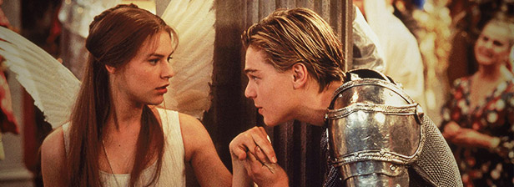
Romeo & Juliet Act 3 Scene 5

Slide 2
Learning Objectives
What? We will practise our language analysis skills by focusing on Capulet’s changed decision.
How? We will read Act 3, Scene 5. We will complete some writing tasks and identify the language features used in this scene. We will write a PEARAW.
Why? To continue exploring the theme of decisions, focusing on the character Lord Capulet.

Slide 3
Act 3, Scene 5
We know Paris and Capulet have decided the wedding will be next Thursday - now Lord Capulet must break the news to Juliet…
When characters feel ANGRY or UPSET:
Harsh vocabulary
Short sentences
Exclamations
Expletives
Look out for examples of these as we read!

Slide 4
Capulet isn’t very happy…but how do we know?
Capulet: How how! How how, chop- logic! What is this?
Short sentences
Exclamation
Harsh vocabulary
Repetition
What language features can we see here?

Slide 5
You must now: 1) Translate this quote. 2) Identify the language features. 3) Identify the dramatic irony in this. 4) Think about the decision Lord Capulet is making here – is this surprising in regards to the context? 5) What is the EFFECT of the language features and the dramatic irony?
Capulet: Hang thee, young baggage! Disobedient wretch! I tell thee what; get thee to church o’ Thursday, Or never after look me in the face.

Slide 6
PEE Practise
Write a PEE paragraph about:
Lord Capulet’s decision to force Juliet to Marry Paris.
OR
Juliet’s reaction to her Father’s decision that she has to marry Paris.
OR
How Lord Capulet’s decision here links in with the historical context – is it surprising?
Use your answers from the last task to help you!

