Slide 1
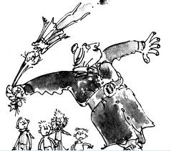
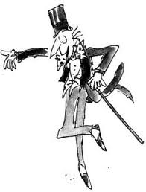
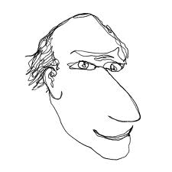
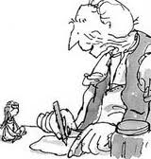
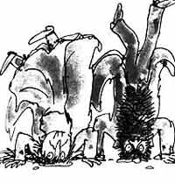
Roald Dahl

Slide 2
Roald Dahl’s Holiday
Answer the following questions with quotations as supporting evidence.
Where did Roald Dahl go on holiday every year?
How did they get there?
What did they eat at the family dinner?
How did he spend his days on the island?
What was the hotel like that they stayed in? 6. Write a description of your favourite place
using 5 WOW words. Underline or highlight the WOW words.

